Slide 1
Setting Boundaries: Maintaining Mental Health by Understanding your limits
By Ryan Soekarmoen

Slide 2




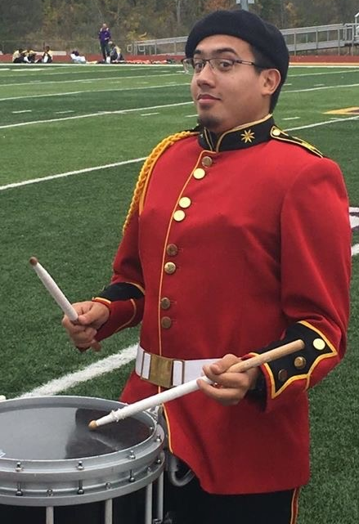
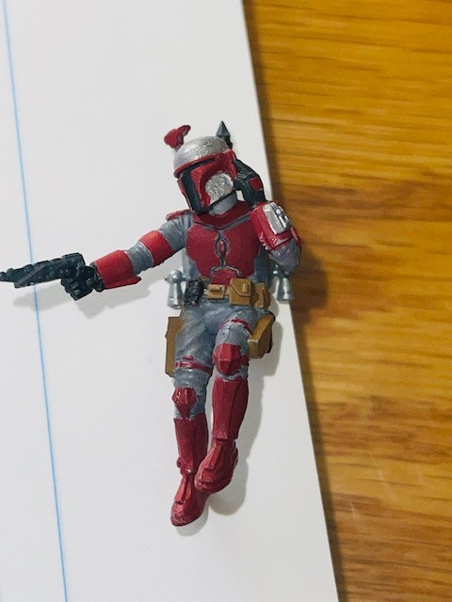
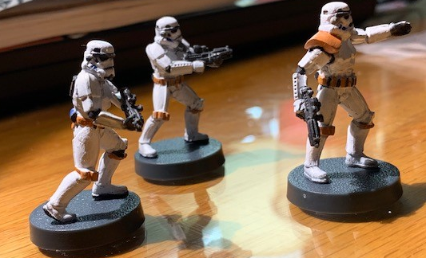
Ryan Soekarmoen
Hometown: Vicksburg Mi
Lives in: Ann Arbor, Mi
Engaged: Nichole Brown
Pets: 2 cats, Tux and Bear
Bear
Tux
Music
Passions
*Board Games
*Video Games
*Music
*Star Wars Miniatures
Painting Miniatures
2013-2018
2018-2022
2022-Present
Albion College
Started as a Physics Major, ended as a Music Major
Did summer research with CAD summer of 2013! (SketchUp)
Bachelors in Fine Arts: General Music
Toyota North America
Joined June 25th, 2018
Contractor: Data Management Engineer Office: Saline, MI
Rehmann
Joined January 24th, 2022
Staff: Data Analyst
Office: Ann Arbor
Ensembles
Jazz Band
Marching Band
Symphonic Band
Orchestra
Music Fraternities
Phi Mu Alpha
Kappa Kappa Psi
Officer Roles
Treasurer
President
FEO
ARO

Slide 3
What are Boundaries?
A set definition of actions or words that are acceptable to us.
How often do you think about boundaries?
Do you regularly discuss boundaries with your family, friends, partners?
Types of Boundaries
Emotional
Time
Material
Intellectual
Physical
Sexual

Slide 4
Why Boundaries are Important?
Respect for yourself
Be confident in your worth!
Knowing your limitations allows you to be full productive when you are present
Prevent burnout
Especially important in today’s hybrid world
Prevent health issues
Increase performance
Healthy Mind & Body = Increased ability to create music or productivity

Slide 5
Emotional Boundaries
What is it?
Respecting an individual’s feelings and thoughts on a given subject
What methods do you use to communicate? How do you receive information best?
Examples of setting this boundary
“This topic makes me uncomfortable. Can we discuss something else?”
“I’m overwhelmed at the moment, I need to take an extra moment before I respond so I convey how I feel about this”
Examples of breaking this boundary
Telling someone how to feel about an event or person.
“oh don’t mind them, that’s just how they are”
“Being scared is part of the fun!”
Dismissing or criticizing feelings
“Oh grow up”
“Don’t be such a baby about this”

Slide 6
Time Boundaries
What is it?
Respecting an individual’s schedule
How full is your schedule? Do you have the energy for that activity?
Examples of setting this boundary
“My schedule is full right now. Circle back with me in X days/weeks/months when my schedule is a little lighter!”
This is a 2 for 1 as you set your boundary, but gives a concrete timeframe for when you would be more amenable to the event!
“I would love to come, but will need to leave after an hour”
Examples of breaking this boundary
Contacting people when they said they’re unavailable.
Showing up late to a planned event
Failing to deliver because we overbooked and didn’t request help.

Slide 7
Material Boundaries
What is it?
Respecting an individual’s material belongings
What items are you willing to share vs. what items are for your use only
Examples of setting this boundary
“This is my personal instrument; I would prefer that I’m the only one using it”
“You can borrow for one week, but I need it back by Thursday at 5pm.”
Examples of breaking this boundary
Borrowing something without asking the owner
Yes, even if its “only for a moment”
Breaking someone’s possession when you weren’t given permission to use it
Monopolizing time with a communal item

Slide 8
Intellectual Boundaries
What is it?
Respecting an individual’s thoughts and ideas
Was your idea/character belittled by someone else?
How are you managing your expectations of other people? Are you expecting them to complete things the way you would?
Examples of setting this boundary
“I know that my methods are not the same as your, but I know how to do this way. Please allow me to use my method to complete this activity”
“I am just starting to learn how to do this so if there are errors, please make a note of them and plan on walking me through
Examples of breaking this boundary
Belittling someone after they make a mistake
Pushing your expectations on someone else and not allowing them to do things their way
NOTE: Don’t confuse this for excusing when they don’t deliver, just understand that their results may vary from how YOU would have done it

Slide 9
Physical Boundaries
What is it?
Respect for an individual’s personal space
Be confident in sharing your preference for greeting people. (i.e. are you OK with shaking hands or do you prefer waving/nodding?)
Being conscious of people’s body language and speaking up for someone if they seem uncomfortable
Examples of setting this boundary
“I prefer to wave instead of shaking hands/hugging when we greet.”
“I’m feeling a little crowded at the moment, can you move over?”
“I’m very ticklish, so please don’t tickle me”
Examples of breaking this boundary
Disregarding when someone requests additional space
Actively invading someone’s personal space
Assuming past consent applies to the current moment
Very important for partners as their personal space needs can change

Slide 10
Sexual Boundaries
What is it?
Respect for another person’s body
ALWAYS ask for consent.
Examples of setting this boundary
“I am comfortable with A, B, and C but am not comfortable with X, Y, Z.
Clearly defines what activities are ok and which are NOT
“I have changed my mind, I no longer wish to have sex”
Examples of breaking this boundary
Trying to get someone to participate in an act they have clearly said they aren’t willing to do
Assuming past consent is still valid
Again, ALWAYS ask for consent.

Slide 11
Building Your Boundaries
Reflect on things that make you comfortable (within your boundaries) and things that make you uncomfortable (outside your boundaries)
Write down 3 boundaries for each of the Boundary Types described above
Practice (or write down) phrases you could use to convey those boundaries
Consider how you would respond if someone breaks that boundary.
Your response should be calm, but steadfast and firm
Reflect on times you may have broken someone’s boundary and decide how you could have done things differently.

Slide 12
Final Thoughts
May is Mental Health Month!
Boundaries aren’t processes to keep people out, but rather processes to allow people in.
Be firm with your boundaries! Let people know if they cross a boundary and provide insight to how they can prevent that from happening again.
When informing people that they crossed a boundary, be calm but firm about it. Accidents happen but be cognitive of patterns.
Create space to discuss boundaries with those around you
Friends
Family
Chapter Brothers

Slide 13
Resources
Find Help with finance, food pantries, medical care at https://www.findhelp.org/
National Alliance on Mental Illness: Navigating a Mental Health Crisis
RAINN: Resources for victims of sexual violence
Mental Text Line: Text “HOME” to 741741 or visit their website
Suicide Prevention Hotline

